Slide 1
SURF 2024 – 8th Meeting
Ryan Hsieh 2024/07/10

Slide 2
AGENDA
Data Mapping: Substations vs EPA Power Plants Data
Optimization Model Computation Equations & Programming Functions

Slide 3
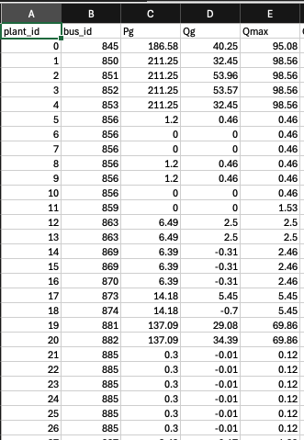
Plant id issue
Several power plants can be mapped to one bus / substation ==> Many to one situation
BE uses power plant data from EIA's plant data = 100% legit
Issue : Given data for plant doesn't have the coordinates, only sub stations have the coordinates ==> can't directly map plant_id (BE) to EPA plants
Should we map directly to EIA's plant data instead? No

Slide 4
Plan for mapping
Discussed w/ Prof. Siva
Instead of mapping plant ID to EPA plants ==> perhaps map at the substation level
Could have many plants inside, but we could figure out the mapping based on the closeness of locations
Since generators are sparsely located around the country ==> Categorized BE ones that are withing certain radius of EPA ones as being part of that particular substation
Issue Facing (Still working):
Tolerance range of the coordinates and distance for power plants considering categorized to that substation
KDTree not familiar but doable
= generators = substation

Slide 5
Optimization Model Computation Equations & Programming Functions
Walkthrough of the six parts

Slide 6
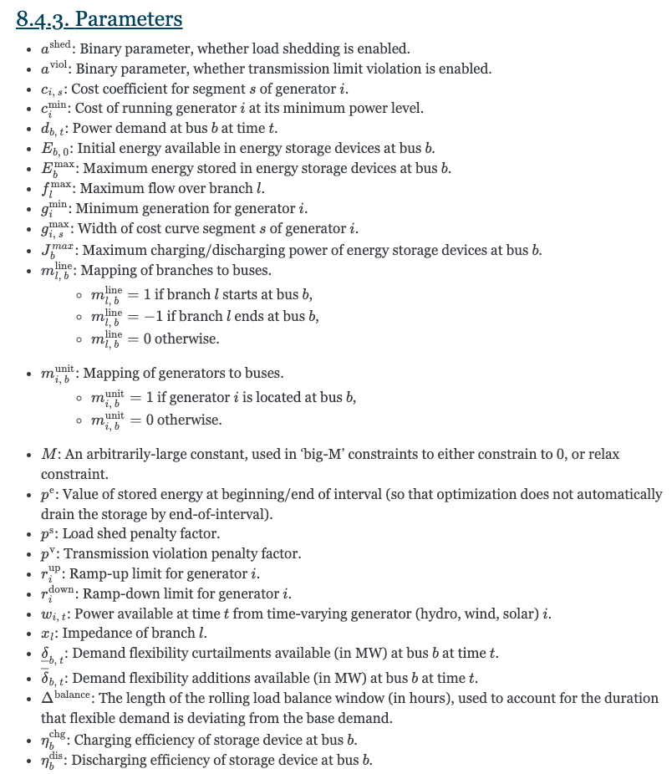
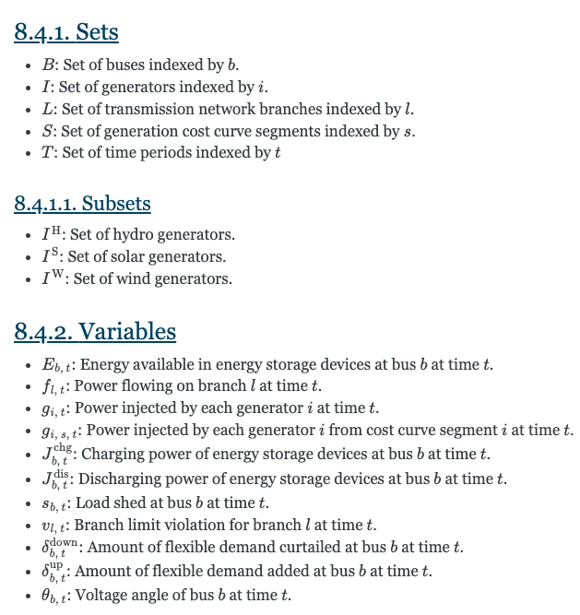
Optimization Model
JuMP = solver-agnostic model
Can be inputting various solver(GLPK or Gurobi)

Slide 7
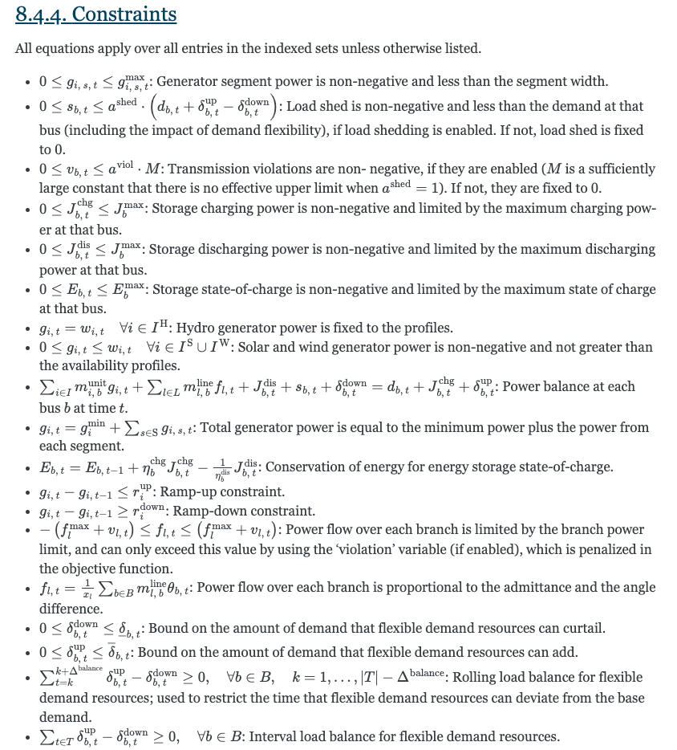
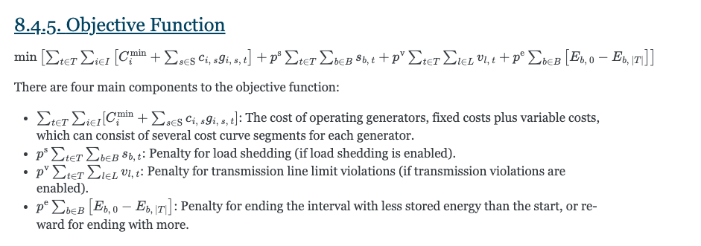
Optimization Model
JuMP = solver-agnostic model
Can be inputting various solver(GLPK or Gurobi)
6 parts into 18 Julia-based functions
OPTIMIZATION MODEL
6

Slide 8
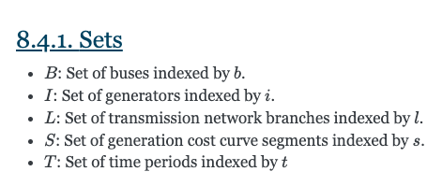
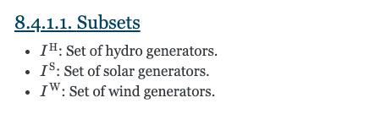
Sets&subsets
Functions | Description
_make_sets(case; storage=nothing, demand_flexibility=nothing) | Creates sets and mappings required for the optimization model, including buses, branches, generators, and segments. Also handles subsets like profile-based generators (hydro, solar, wind) if present.

Slide 9
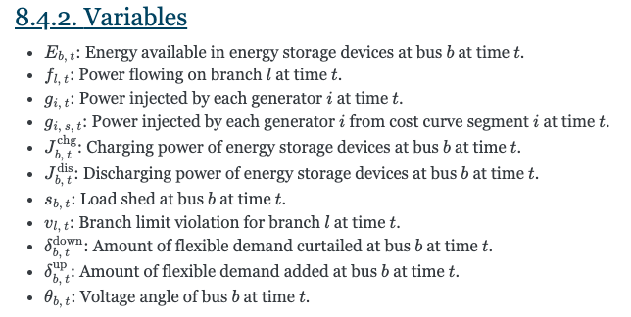
Variables
Functions | Description
_build_model | Declares variables for the model, including generation, power flow, state of charge, load shedding, etc.

Slide 10
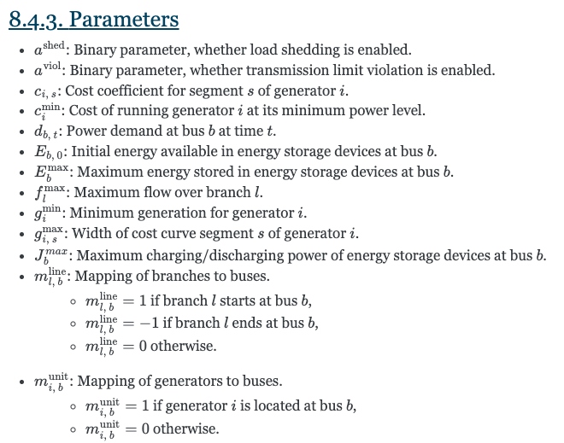
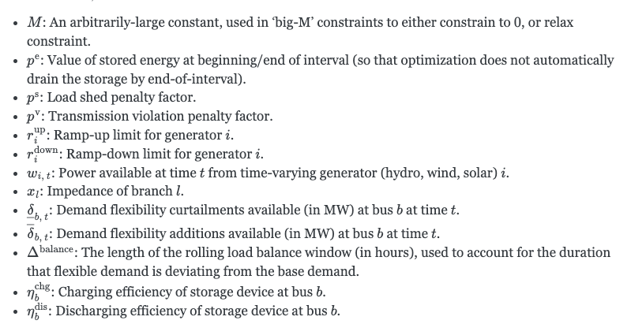
Parameters
Functions | Description
_make_gen_map(case) | Generates a sparse matrix representing generator topology.
_make_branch_map(case) | Generates a sparse matrix representing branch topology.
_make_gen_map(case) | Builds a matrix of bus demands over a specified interval.
_make_gen_map(case) | Creates matrices for demand flexibility amounts over an interval.
_make_gen_map(case) | Calculates segment slopes for piecewise linear generation cost curves.

Slide 11
Constraints
Functions | Description
_add_constraint_power_balance!(m, case, sets, storage, demand_flexibility, bus_demand, load_shed_enabled) | Adds power balance constraints to the optimization model.
_add_constraint_load_shed!(m, sets, demand_flexibility, bus_demand) | Adds load shedding constraints to the optimization model.
_add_constraints_storage_operation!(m, sets, storage, interval_length, storage_e0) | Adds storage operation constraints to the optimization model.
_add_constraints_demand_flexibility!(m, sets, demand_flexibility, interval_length, init_shifted_demand) | Adds demand flexibility constraints to the optimization model.
_add_constraints_initial_ramping!(m, case, sets, initial_ramp_g0) | Adds initial ramping constraints to the optimization model.
_add_constraints_ramping!(m, case, sets, interval_length) | Adds ramping constraints to the optimization model.
_add_constraints_generator_segments!(m, case, sets, hour_idx) | Adds generator segment constraints to the optimization model.
_add_constraints_branch_flow_limits!(m, case, sets, trans_viol_enabled, hour_idx) | Adds branch flow limits constraints to the optimization model.
_add_branch_angle_constraints!(m, case, sets, hour_idx) | Adds branch angle constraints to the optimization model.
_add_profile_generator_limits!(m, case, sets, hour_idx, start_index, interval_length) | Adds limits for profile-based generators to the optimization model.

Slide 12
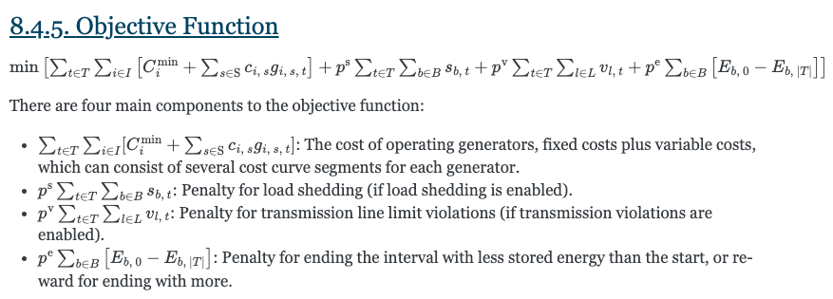
Objective Function
Functions | Description
_add_objective_function!(m, case, sets, storage, start_index, end_index, interval_length, load_shed_enabled, load_shed_penalty, trans_viol_enabled, trans_viol_penalty, storage_e0, demand_flexibility) | Adds the objective function to the optimization model, incorporating costs for generation, load shedding, transmission violations, and storage.

Slide 13
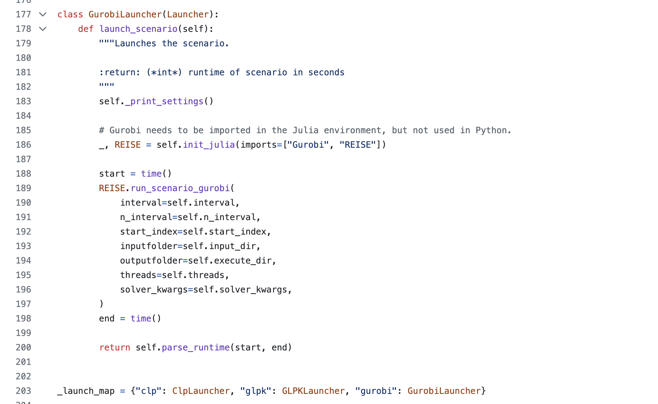
Optimization SOlver Launcher
Solver Launched as input
Loc: REISE.jl/pyreisejl/utility/launchers.py

